Slide 1
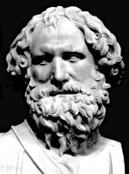

powerpointmaths.com
3:2
Quality resources for the mathematics classroom
Reduce your workload and cut down planning
Enjoy a new teaching experience
Watch your students interest and enjoyment grow
Key concepts focused on and driven home
Over 100 files available with many more to come
1000’s of slides with nice graphics and effects.
powerpointmaths.com
Get ready to fly!
© Powerpointmaths.com All rights reserved.

Slide 2




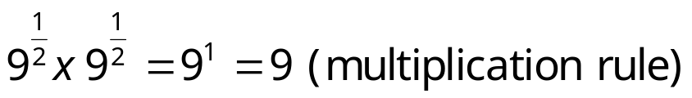
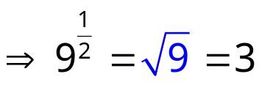
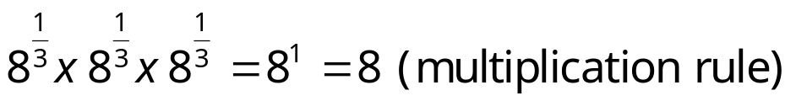
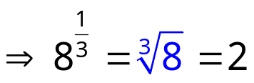
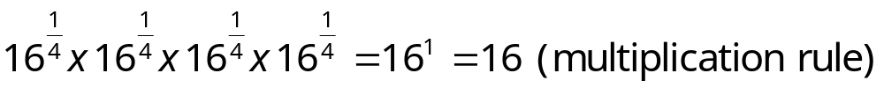
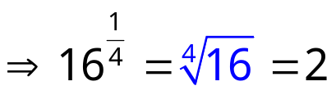
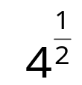
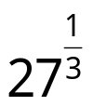
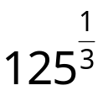
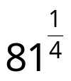
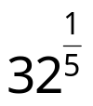



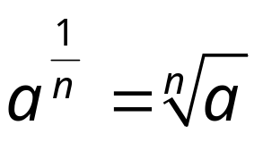
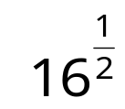
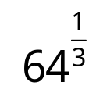
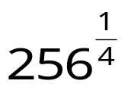
Fractional Indices
Multiplication Rule
a^{m} x a^{n} = a^{m+n}
a⁰ = 1
Division Rule
a^{m} ÷ a^{n} = a^{m-n}
Power Rule
(a^{m})^{n} = a^{mn}
Negative Index Rule
Consider the following:
Evaluate the following:
Write in index form:
So in general:
2
3
5
3
2

Slide 3

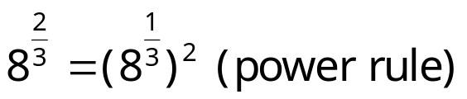
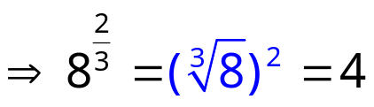
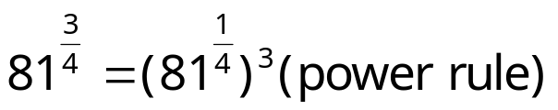
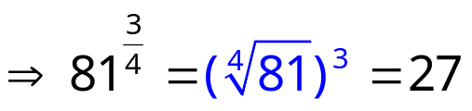
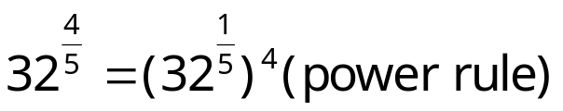
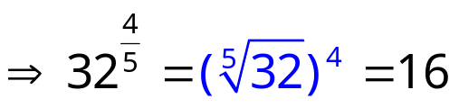
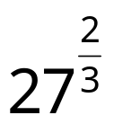
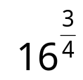
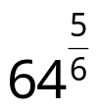
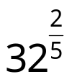
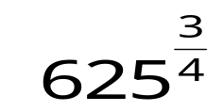
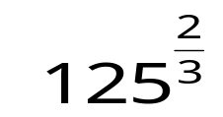
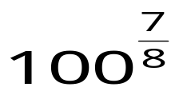
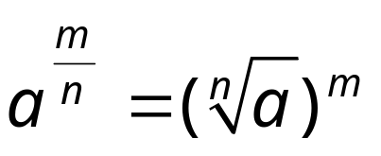



Fractional Indices
Multiplication Rule
a^{m} x a^{n} = a^{m+n}
Division Rule
a^{m} ÷ a^{n} = a^{m-n}
a⁰ = 1
Power Rule
(a^{m})^{n} = a^{mn}
Negative Index Rule
Unit Fraction Rule
Consider the following:
Evaluate the following:
Write in index form:
So in general:
9
8
32
4

Slide 4

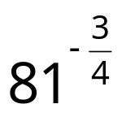
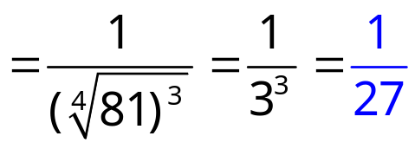
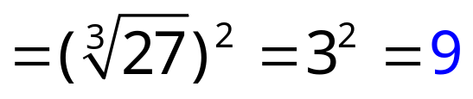
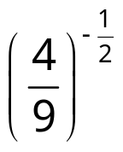
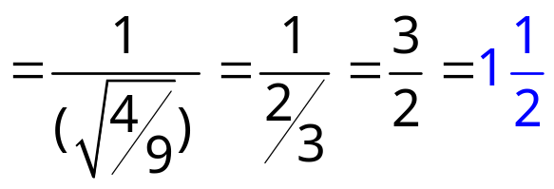

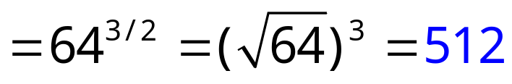
Fractional Indices
Multiplication Rule
a^{m} x a^{n} = a^{m+n}
a⁰ = 1
Division Rule
a^{m} ÷ a^{n} = a^{m-n}
Power Rule
(a^{m})^{n} = a^{mn}
Negative Index Rule
Unit Fraction Rule
General Fraction Rule
Evaluate the following:

Slide 5
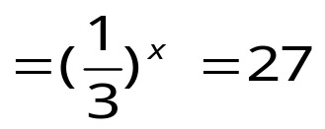
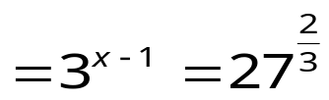
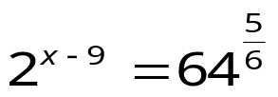
Equations Involving Indices
Multiplication Rule
a^{m} x a^{n} = a^{m+n}
a⁰ = 1
Division Rule
a^{m} ÷ a^{n} = a^{m-n}
Power Rule
(a^{m})^{n} = a^{mn}
Negative Index Rule
Unit Fraction Rule
General Fraction Rule
Solve the following:
6^{2x} = 36
⇒6^{2x} = 6²
⇒2x = 2
⇒ x = 1
⇒(3⁻¹)^{x} = 27
⇒ 3^{-x} = 3³
-x = 3
x = -3
⇒ 3^{x-1} = 9
⇒ 3^{x-1} = 3²
x - 1 = 2
x = 3
⇒2^{x-9} = 32
⇒ 2^{x-9} = 2⁵
x - 9 = 5
x = 14

